Slide 1
Accounting Principles
Thirteenth Edition
Weygandt ● Kimmel ● Kieso
Chapter 10
Plant Assets, Natural Resources, and Intangible Assets
This slide deck contains animations. Please disable animations if they cause issues with your device.

Slide 2
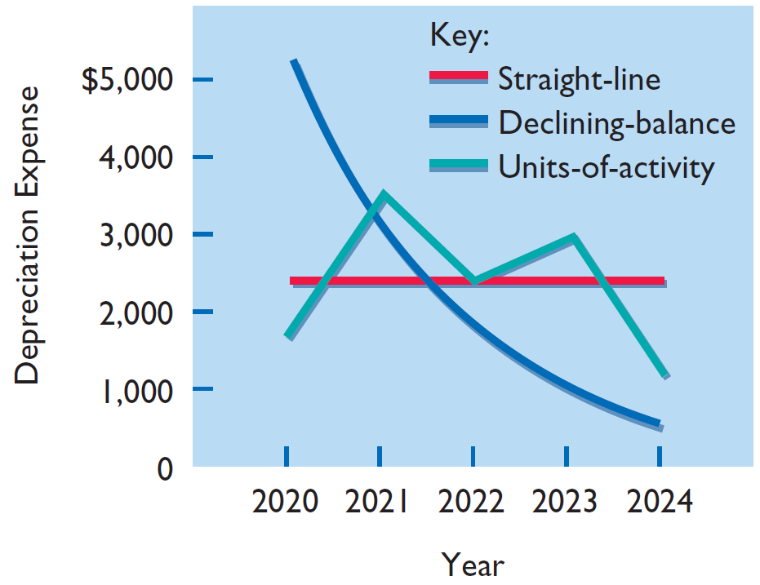
Comparison of Depreciation Methods
Year | . | Straight-Line | . | Units-of-Activity | . | Declining- Balance
2020 |  | $ 2,400 |  | $ 1,800 |  | $ 5,200
2021 |  | 2,400 |  | 3,600 |  | 3,120
2022 |  | 2,400 |  | 2,400 |  | 1,872
2023 |  | 2,400 |  | 3,000 |  | 1,123
2024 |  | 2,400 |  | 1,200 |  | 685
 |  | $12,000 |  | $12,000 |  | $12,000
Annual depreciation expense varies considerably among the methods, but total depreciation expense is the same ($12,000) for the five-year period under all three methods. Each method is acceptable in accounting because each recognizes in a rational and systematic manner the decline in service potential of the asset. The graph above shows the depreciation expense pattern under each method.

Slide 3
Depreciation and Income Taxes
I R S (US tax authority) does not require companies to use the same depreciation method on the tax return (when paying tax) that is used in preparing financial statements.
The company will deduct depreciation expense (on the income statement), when they compute net income. They may choose any of the 3 methods to do this (sometimes companies choose the method which maximizes their net income i.e. the method that shows lowest depreciation expense).
At the same time, when paying tax, they may use a special deprecation method called Modified Accelerated Cost Recovery System (MACRS) to minimize their income taxes (by showing higher depreciation expense and therefore lower net income).
Rule: When filing tax returns (or paying tax), companies must use either the straight-line method or a MACRS (not allowed to use the other 2 methods).
M A C R S is NOT acceptable under G A A P.

Slide 4
Revising Periodic Depreciation (1 of 3)
When a change in an estimate is required, the company makes the change in current and future years.
  It does not change depreciation in prior periods.
To determine the new annual depreciation expense:
  the company first computes the asset’s new depreciable cost at the time of the revision.
  It then divides the revised depreciable cost by remaining useful life
  Example on next slide
Notes:
Supplementary notes by TBR:
Why change in estimate may be required: Depreciation is one example of the use of estimation in the accounting process. Management should periodically review annual depreciation expense. If wear and tear or obsolescence indicate that annual depreciation estimates are inadequate or excessive, the company should change the amount of depreciation expense.

Slide 5
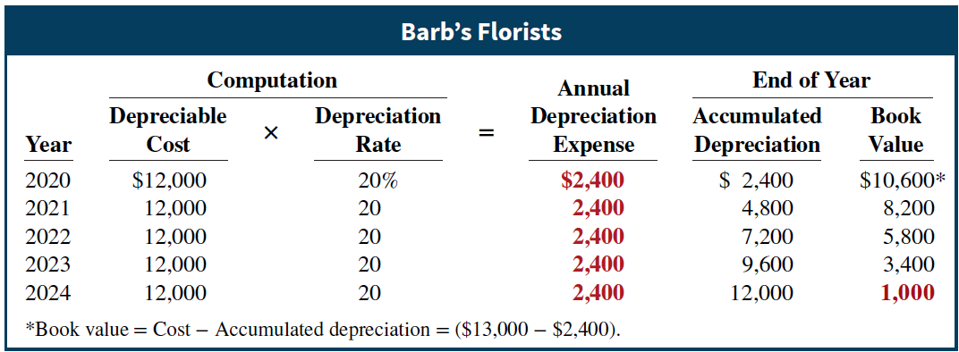
Revising Periodic Depreciation (2 of 3)
Barb’s Florists decides on January 1, 2023, to extend the useful life of the truck one year (a total life of six years) and increase its salvage value to $2,200. The company has used the straight-line method to depreciate the asset to date. Accumulated depreciation after three years (2020–2022) is $7,200, and book value is $5,800.

Slide 6
Revising Periodic Depreciation (3 of 3)
a) Calculate the depreciation expense for 2023 and future years.
Book value, January 1, 2023 | $ 5,800
Less: Salvage value | 2,200
Depreciable cost | $ 3,600
Remaining useful life | 3 years (2023−2025)
Revised annual depreciation ($3,600 ÷ 3) | $ 1,200
b) What entry is necessary to correct prior year's deprecation?
Barb’s Florists makes no entry for the change in estimate.
Notes:
Supplementary notes by TBR:
(New) depreciation cost = Remaining Book Value - New Salvage Value
The (remaining) book value represents the portion of the asset's cost that has not yet been expensed. It's the amount that still needs to be depreciated over the remaining useful life.
Therefore, we use the book value, not the original cost, to calculate the new depreciation expense.
Think of it like this: The accumulated depreciation has already accounted for the "past" depreciation. Now, we're looking forward. The book value is the "now" value, and we need to depreciate that "now" value, minus the new salvage value, over the rest of the assets life.

Slide 7
DO IT AT HOME! 2b Revised Depreciation (1 of 2)
Chambers Corporation purchased a piece of equipment for $36,000. It estimated a 6-year life and $6,000 salvage value. Thus, straight-line depreciation was $5,000 per year [($36,000 − $6,000) ÷ 6]. At the end of year three (before the depreciation adjustment = meaning after 2 years of depreciation), it estimated the new total life to be 10 years and the new salvage value to be $2,000. Compute the revised depreciation.
Solution
Original depreciation expense = [($36,000 − $6,000) ÷ 6] = $5,000
Accumulated depreciation after 2 years = 2 × $5,000 = $10,000
Book value = $36,000 − $10,000 = $26,000

Slide 8
DO IT AT HOME! 2b Revised Depreciation (2 of 2)
Book value after 2 years of depreciation | $26,000
Less: New salvage value | 2,000
Depreciable cost | $24,000
Remaining useful life | 8 years
Revised annual depreciation ($24,000 ÷ 8) | $ 3,000

Slide 9
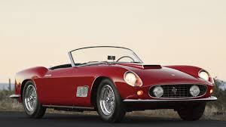
Difference between book value and fair value
(supplementary notes by TBR)
Book Value:
  This is like the car's value on your "accounting records“. You bought it for $20,000, and over time, it depreciates (as you are using it). After a few years, your "book value" might be $10,000. This is based on the car's original cost minus its depreciation.
Fair Value:
  This is what you could actually sell the car for today. If the used (second hand) car market is strong, you might sell it for $12,000. If it's weak, you might only get $8,000. This "fair value" is the current market price.
Therefore, the book value of the car, and the fair market value of the car, will rarely be the same.

Slide 10
Impairments - what happens when fair value < book value?
Book value = cost – accumulated depreciation; Fair value = market value
As noted earlier, the book value of plant assets is rarely the same as the fair value.
Now, let’s imagine a machine you bought earlier has become obsolete (out of date), or the market for the product made by the machine has dried up or has become very competitive. This might cause the market value of your machine to decline substantially, and its fair value might fall materially (significantly) below book value.
A permanent decline (decrease in the asset's fair value is not expected to recover) in the fair value of an asset is referred to as an impairment. So as not to overstate (overestimate) the asset on the books, the company records a write-down, whereby the asset’s cost is reduced to its new fair value during the year in which the decline in value occurs.
E.g. Recently, Disney recorded a $200 million write-down on its action movie John Carter. Disney spent more than $300 million producing the film.
Loss on Impairment of Film Asset DR $200,000,000 (INCOME STATEMENT)
Film Asset (or Inventory - Film Production) CR $200,000,000 (BALANCE SHEET)
Notes:
Supplementary notes by TBR:
"Permanent decline" in the context of asset impairment means that the decrease in the asset's fair value is not expected to recover. It's not a temporary dip due to short-term market fluctuations; it's a long-lasting or irreversible loss. Indicators of a permanent decline can include:
Obsolescence of the asset (the process of becoming obsolete or outdated and no longer used).
Significant adverse changes in the market.
Legal or regulatory changes.
Physical damage to the asset.
A company's decision to restructure, and those assets will not be used in the future.
Essentially, a permanent decline signals that the asset's future economic benefits have been reduced, and the company needs to recognize this loss in its financial statements.

Slide 11
Plant Asset Disposals
Companies dispose (get rid of) of plant assets in three ways:
Retirement: Equipment is scrapped or discarded
Sale: Equipment is sold to another party
Exchange: Equipment is traded for new equipment
Record depreciation up to the date of disposal.
Eliminate asset by (1) debiting Accumulated Depreciation, and (2) crediting the asset account.

Slide 12
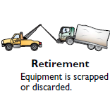
Retirement of Plant Asset (1 of 3)
No cash is received
Decrease (credit) asset account for original cost in asset
Decrease (debit) Accumulated Depreciation for full amount of depreciation taken over life of asset

Slide 13
Retirement of Plant Asset (2 of 3)
Illustration: Hobart Enterprises retires its computer printers, which cost $32,000. The accumulated depreciation on these printers is $32,000. Prepare the entry to record this retirement. The equipment, therefore, is fully depreciated (zero book value).
Accumulated Depreciation—Equipment
32,000
Equipment
32,000
(To record retirement of fully-depreciated equipment)
Question: What happens if a fully depreciated plant asset is still useful to the company?
Answer: The asset and its accumulated depreciation continue to be reported on the balance sheet, without further depreciation adjustment, until the company retires the asset.
Notes:
Supplementary notes by TBR:
What happens if a fully depreciated plant asset is still useful to the company? In this case, the asset and its accumulated depreciation continue to be reported on the balance sheet, without further depreciation adjustment, until the company retires the asset. Reporting the asset and related accumulated depreciation on the balance sheet informs the financial statement reader that the asset is still in use. Once fully depreciated, no additional depreciation should be taken, even if an asset is still being used. In no situation can the accumulated depreciation on a plant asset exceed its cost.

Slide 14
Retirement of Plant Asset (3 of 3)
If a company retires a plant asset before it is fully depreciated and no cash is received for scrap or salvage value, a loss on disposal occurs.
Illustration: Sunset Company discards delivery equipment that cost $18,000 and has accumulated depreciation of $14,000. The journal entry is?
Accumulated Depreciation—Equipment
14,000
Loss on Disposal of Plant Assets
4,000
Equipment
18,000
(To record retirement of delivery equipment at a loss)
Companies report a loss on disposal in the “Other expenses and losses” section of the income statement.

Slide 15
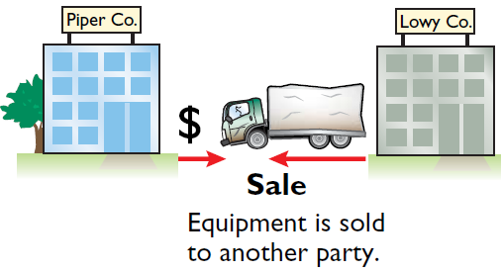
Sale of Plant Asset (1 of 2)
Compare the book value of the asset with the proceeds received from the sale
If proceeds exceed the book value, a gain on disposal occurs
If proceeds are less than the book value, a loss on disposal occurs

Slide 16
Sale of Plant Asset (2 of 2)
Gain on Sale
Illustration: On July 1, 2020, Wright Company sells office furniture for $16,000 cash. The office furniture originally cost $60,000. As of January 1, 2020, it had accumulated depreciation of $41,000. Depreciation for the first six months of 2020 is $8,000. Prepare the journal entry to record depreciation expense up to the date of sale.
Jul. 1
Depreciation Expense
8,000
Accumulated Depreciation—Equipment
8,000
(To record depreciation expense for the first 6 months of 2020)

Slide 17
Gain on Sale
Cost of office furniture | $60,000
Less: Accumulated depreciation ($41,000 + $8,000) | 49,000
Book value at date of disposal | 11,000
Proceeds from sale | 16,000
Gain on disposal of plant asset | $ 5,000
Wright records the sale as follows.
Jul. 1
Cash
16,000
Accumulated Depreciation—Equipment
49,000
Equipment
60,000
Gain on Disposal of Plant Assets
5,000
(To record sale of office furniture at a gain)

Slide 18
Loss on Sale
Assume that instead of selling the office furniture for $16,000, Wright sells it for $9,000. In this case, Wright computes a loss of $2,000.
Cost of office furniture | $60,000
Less: Accumulated depreciation ($41,000 + $8,000) | 49,000
Book value at date of disposal | 11,000
Proceeds from sale | 9,000
Loss on disposal of plant asset | $ 2,000
Wright records the sale as follows.
Cash
9,000
Accumulated Depreciation—Equipment
49,000
Loss on Disposal of Plant Assets
2,000
Equipment
60,000
(To record sale of office furniture at a loss)

Slide 19
Do It AT HOME! 3: Plant Asset Disposal (1 of 2)
Overland Trucking has decided to sell an old truck that cost $30,000 and which has accumulated depreciation of $16,000. (a) What entry would Overland Trucking make to record the sale of the truck for $17,000 cash?
Cash
17,000
Accumulated Depreciation—Equipment
16,000
Equipment
30,000
Gain on Disposal of Plant Assets
3,000
[$17,000 − ($30,000 − $16,000)]
(To record sale of truck at a gain)

Slide 20
Do It AT HOME! 3: Plant Asset Disposal (2 of 2)
Overland Trucking has decided to sell an old truck that cost $30,000 and which has accumulated depreciation of $16,000. (b) What entry would Overland Trucking make to record the sale of the truck for $10,000 cash?
Cash
10,000
Accumulated Depreciation—Equipment
16,000
Loss on Disposal of Plant Assets
[$10,000 − ($30,000 − $16,000)]
4,000
Equipment
30,000
(To record sale of truck at a loss)

Slide 21
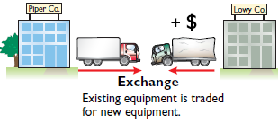
Exchange of Plant Assets
Companies record a gain or loss on exchange of plant assets because most exchanges have commercial substance (even when similar assets are exchanged).
Commercial substance exists if future cash flows change as a result of exchange.
To illustrate, Ramos Co. exchanges some of its equipment for land held by Brodhead Inc. It is likely that the timing and amount of the cash flows arising from the land will differ significantly from the cash flows arising from the equipment. As a result, both Ramos and Brodhead are in different economic positions. Therefore, the exchange has commercial substance, and the companies recognize a gain or loss in the exchange.
Notes:
“Exchange of Plant Assets”: this section is from Appendix 10A in your book
Supplementary notes by TBR:
"It is likely that the timing and amount of the cash flows arising from the land will differ significantly from the cash flows arising from the equipment." It means:
Timing: The land might generate cash flows at different times compared to the equipment (e.g., land might be sold in the future, whereas equipment generates cash flows from its usage).
Amount: The amount of cash flows generated by the land is expected to be different from the amount generated by the equipment.
In other words, the economic benefit of owning land is different than owning equipment.
“As a result, both Ramos and Brodhead are in different economic positions.” It means:
The equipment has a certain function and generates cash flows through its usage whereas the land represents a different type of asset with potentially different future cash flows (e.g., from future sale, development, or rental).
The exchange has altered the financial landscape for both companies. They now hold different assets that will affect their future economic outcomes in distinct ways.
“Therefore, the exchange has commercial substance, and the companies recognize a gain or loss in the exchange.“ It means:
This refers back to the earlier point that the cash flows of the exchanged assets are significantly different.
Because the exchange has commercial substance, accounting rules require that any gain or loss resulting from the transaction be recorded in the companies' financial statements.
This gain or loss is the difference between the fair value of what was received and the book value of what was given up (refer to the subsequent slides).
“even when similar assets are exchanged”. It means:
Even when similar assets are exchanged, there are often differences in the condition, age, or functionality of the assets that will cause a change in future cash flows.
For example, a company might trade in an old, inefficient machine for a newer, more productive one.
This exchange is likely to increase future production and reduce operating costs, giving it commercial substance.

Slide 22
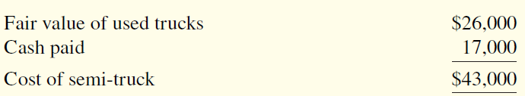
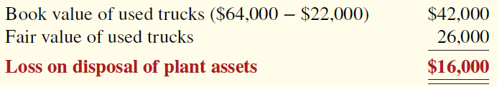
Exchange of Plant Assets (loss)
Loss Treatment: To illustrate an exchange that results in a loss, assume that Roland Company exchanged a set of used trucks plus cash for a new semi-truck. The used trucks have a combined book value of $42,000 (cost $64,000 less $22,000 accumulated depreciation). Roland’s purchasing agent, experienced in the secondhand market, indicates that the used trucks have a fair value of $26,000. In addition to the trucks, Roland must pay $17,000 for the semi-truck.
Roland incurs a loss on disposal of plant assets of $16,000 on this exchange. The reason is that the book value of the used trucks is greater than the fair value of these trucks.

Slide 23
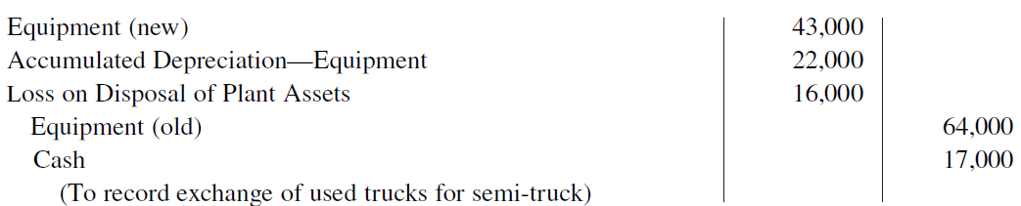
Exchange of Plant Assets (loss)
In recording an exchange at a loss, four steps are required:
eliminate the book value of the asset given up,
record the cost of the asset acquired,
recognize the loss on disposal of plant assets, and
record cash paid or received.
Roland Company thus records the exchange on the loss as follows.
(2)
(1)
(3)
(1)
(4)
Notes:
Supplementary notes by TBR:
Eliminate (book value of the) asset by (1) debiting Accumulated Depreciation, and (2) crediting the asset account. (from first slide of Plant Asset Disposals)
Extra: I am getting a new equipment worth $43,000 (= fair value of old equipment + cash paid). I am giving up an old equipment worth $42,000 (BV = cost – acc dep) + cash of $17,000. Therefore, $43,000 – ($42,000 + $17,000) = $16,000 (loss)

Slide 24
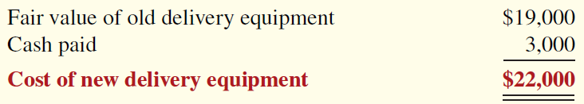
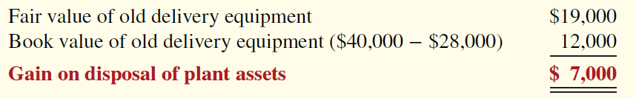
Exchange of Plant Assets (gain)
Gain Treatment: To illustrate a gain situation, assume that Mark Express Delivery decides to exchange its old delivery equipment plus cash of $3,000 for new delivery equipment. The book value of the old delivery equipment is $12,000 (cost $40,000 less accumulated depreciation $28,000). The fair value of the old delivery equipment is $19,000.
A gain results when the fair value of the old delivery equipment is greater than its book value. For Mark Express, there is a gain of $7,000 on disposal of plant assets

Slide 25
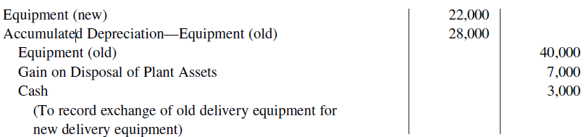
Exchange of Plant Assets (gain)
In recording an exchange at a gain, four steps are required:
eliminate the book value of the asset given up,
record the cost of the asset acquired,
recognize the gain on disposal of plant assets, and
record cash paid or received.
Mark Express Delivery thus records the exchange on the gain as follows.
(2)
(1)
(1)
(3)
(4)
Notes:
Eliminate (book value of the) asset by (1) debiting Accumulated Depreciation, and (2) crediting the asset account. (from first slide of Plant Asset Disposals)

Slide 26
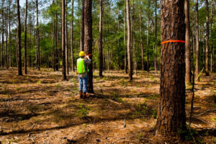
Determining Natural Resources and Intangible Assets
    Natural resources consist of standing timber and underground deposits of oil, gas, and minerals.
    Distinguishing characteristics:
Physically extracted in operations (such as mining, cutting, or pumping), AND
Replaceable only by an act of nature
Cost is the price needed to acquire the resource and prepare it for its intended use.
Notes:
Supplementary notes by TBR:
Standing Timber means trees that are still growing in the forest. It means the trees haven't been cut down yet. So, it's the raw material for lumber (wood that has been processed into uniform and useful sizes) and other wood products, while it is still in its natural environment.

Slide 27
Depletion (1 of 3)
    The allocation of the cost of natural resources to expense in a rational and systematic manner over the resource’s useful life is called depletion.
Companies generally use units-of-activity method to compute depletion
The reason is that depletion generally is a function of the units extracted

Slide 28
Depletion (2 of 3)
    Illustration: Lane Coal Company invests $5 million in a mine estimated to have 1 million tons of coal and no salvage value. In the first year, Lane extracts and sells 250,000 tons of coal. Lane computes the depletion as follows.
Step 1:
 | = | Depletion Cost per Unit
. | = | $5.00 per ton
Step 2: $5.00 × 250,000 = $1,250,000 annual depletion
Journal entry:
Inventory (coal)
1,250,000
Accumulated Depletion
1,250,000
(To record depletion of coal mine)

Slide 29

Intangible Assets
Nike’s trademark
    Intangible assets are rights, privileges, and competitive advantages that result from ownership of long-lived assets (Property, Plant, and Equipment) that do not possess physical substance.
    Evidence of intangibles may exist in the form of contracts or licenses. Intangibles may arise from the following sources:
Government grants, such as patents, copyrights, licenses, trademarks, and trade names.
Acquisition of another business, in which the purchase price includes a payment for goodwill.
Private monopolistic arrangements arising from contractual agreements, such as franchises and leases.
Notes:
Supplementary notes by TBR:
A trademark is a form of intellectual property that consists of a word, phrase, symbol, design, or a combination that identifies a product or service from a particular source and distinguishes it from others.
Nike has several very recognizable trademarks. The most prominent of these are:
The Swoosh: This is the iconic checkmark logo.
"Just Do It": This is their well-known slogan.
Essentially, these are the key elements that make the Nike brand instantly recognizable worldwide.
A patent protects inventions and designs, like engines or a phone casing, and a copyright protects original artistic and literary works, like songs or books.

Slide 30
Accounting for Intangible Assets (1 of 7)
Companies record intangible assets at cost.
Intangibles are categorized as having either a limited life or an indefinite life.
  If an intangible has a limited life, the company allocates its cost over the asset’s useful life using a process called amortization (similar to depreciation).
  The cost of intangible assets with indefinite lives should not be amortized because they are expected to provide economic benefits forever, or at least for a very, very long time with no foreseeable end.
Limited-Life intangibles: To record amortization of an intangible asset, a company
increases (debits) Amortization Expense, and
decreases (credits) the specific intangible asset

Slide 31
Accounting for Intangible Assets (2 of 7)
Patents
Amortize to expense
Exclusive right to manufacture, sell, or otherwise control an invention for 20 years from date of grant
Capitalize costs of purchasing a patent and amortize over 20-year life or its useful life, whichever is shorter
Expense any R&D costs in developing a patent
Legal fees incurred successfully defending a patent are capitalized to Patent account

Slide 32
Patent (3 of 7)
Illustration: Assume that National Labs purchases a patent at a cost of $60,000. National estimates the useful life of the patent to be eight years. National calculates the annual amortization expense as follows.
$60,000 cost ÷ 8 years = $7,500
National records the annual amortization as follows.
Dec. 31
Amortization Expense
7,500
Patents
7,500
(To record patent amortization)

Slide 33
Accounting for Intangible Assets (4 of 7)
Copyrights
Copyright gives the creator (or whoever they transfer the copyright to) the legal power to reproduce and sell an artistic or published work (e.g. a song)
Copyrights extend for the life of the creator plus 70 years (if you create something original, like a song, you own the copyright; that ownership lasts for your entire life, and then for 70 years after you die)
Cost of copyright is cost of acquiring and defending it
Amortized to expense over useful life
Notes:
Amortization similar to patents

Slide 34
Accounting for Intangible Assets (5 of 7)
Trademarks and Trade Names
Word, phrase, jingle, or symbol that identifies a particular enterprise or product
Monopoly, Coca-Cola, Big Mac, and Jeep
Legal protection for indefinite number of 20 year renewal periods
Capitalize acquisition costs
No amortization (because trademarks and trade names have indefinite lives)

Slide 35
Accounting for Intangible Assets (6 of 7)
Franchises
Contractual arrangement between a franchisor and a franchisee
  The franchisor grants the franchisee the right to sell certain products, perform specific services, or use certain trademarks or trade names, usually within a designated geographic area.
KFC and McDonald’s are franchises
Franchise or license (another type of franchise) with a limited life should be amortized to expense over its useful life
If life is indefinite, cost is not amortized
Notes:
Supplementary notes by TBR:
Another type of franchise is a license. A license granted by a governmental body permits a company to use public property in performing its services. Examples are the use of city streets for a bus line or taxi service, the use of public land for telephone and electric lines, and the use of airwaves for radio or TV broadcasting. In a recent license agreement, FOX, CBS, and NBC agreed to pay $27.9 billion for the right to broadcast NFL football games over an eight-year period.

Slide 36
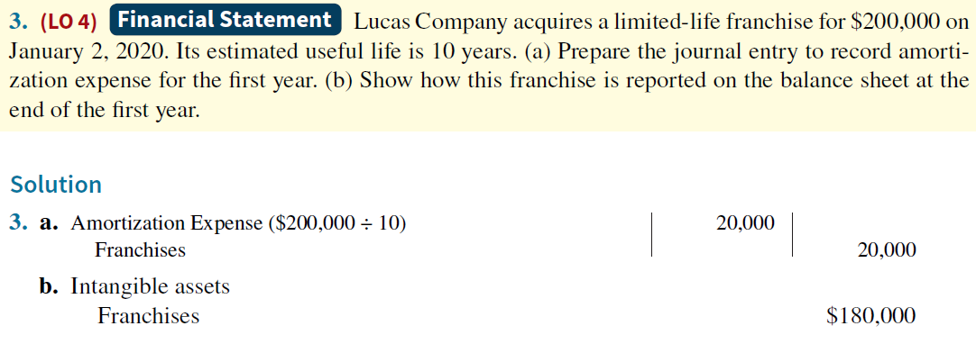
Accounting for Intangible Assets (Franchises)

Slide 37
Accounting for Intangible Assets (7 of 7)
Goodwill
represents the value of all favorable attributes that relate to a company that are not attributable to any other specific asset. These include exceptional management, desirable location, good customer relations, skilled employees, high-quality products, etc.
Only recorded when an entire business is purchased
Goodwill is recorded as excess of purchase price over fair value of net assets acquired
Not amortized (because it is considered to have an indefinite life)
Notes:
Supplementary notes by TBR:
“Only recorded when an entire business is purchased” means:
Goodwill is unique. Unlike assets such as investments and plant assets, which can be sold individually in the marketplace, goodwill can be identified only with the business as a whole.
If goodwill can be identified only with the business as a whole, how can its amount be determined? One could try to put a dollar value on the factors listed above (exceptional management, desirable location, and so on). But, the results would be very subjective, and such subjective valuations would not contribute to the reliability of financial statements. Therefore, companies record goodwill only when an entire business is purchased.
“Goodwill is recorded as excess of purchase price over fair value of net assets acquired” means:
Goodwill arises when a company acquires another company for a purchase price that is higher than the fair value of its net identifiable assets. Here's a simplified example to illustrate the calculation:
Scenario:
Company A acquires Company B.
Company A pays $1,000,000 for Company B.
Company B's identifiable assets (like equipment, inventory, etc.) are valued at $800,000.
Company B's liabilities (like debts) are valued at $100,000.
Calculation:
Calculate Net Identifiable Assets:
Net identifiable assets = Assets - Liabilities
Net identifiable assets = $800,000 - $100,000 = $700,000
Calculate Goodwill:
Goodwill = Purchase Price - Net Identifiable Assets
Goodwill = $1,000,000 - $700,000 = $300,000
Therefore, the goodwill in this transaction is $300,000.
What this means:
Company A paid an extra $300,000 for Company B. This extra amount represents intangible assets that are difficult to quantify, such as:
Brand reputation
Customer loyalty
Strong management
Existing business relationships.
In essence, goodwill is the premium paid for the "intangible value" of a company.

Slide 38
Research and Development Costs
Research and development costs are expenditures that may lead to patents, copyrights, new processes, and new products.
R&D costs present accounting problems. For one thing, it is sometimes difficult to assign the costs to specific projects. Also, there are uncertainties in identifying the extent and timing of future benefits.
  As a result, companies usually record R&D costs as an expense when incurred, whether the research and development is successful or not.

Slide 39
Do It AT HOME! 4: Classification Concepts (1 of 4)
Identify the term most directly associated with each statement.
The allocation of the cost of a natural resource to expense in a rational and systematic manner.
Rights, privileges, and competitive advantages that result from the ownership of long-lived assets that do not possess physical substance.
An exclusive right granted by the federal government to reproduce and sell an artistic or published work.
1.
2.
3.

Slide 40
Do It AT HOME! 4: Classification Concepts (2 of 4)
Identify the term most directly associated with each statement.
The allocation of the cost of a natural resource to expense in a rational and systematic manner.
Rights, privileges, and competitive advantages that result from the ownership of long-lived assets that do not possess physical substance.
An exclusive right granted by the federal government to reproduce and sell an artistic or published work.
1. Depletion
2. Intangible assets
3. Copyrights

Slide 41
Do It AT HOME! 4: Classification Concepts (3 of 4)
Identify the term most directly associated with each statement.
A right to sell certain products or services or to use certain trademarks or trade names within a designated geographic area.
Costs incurred by a company that often lead to patents or new products. These costs must be expensed as incurred.
4.
5.

Slide 42
Do It AT HOME! 4: Classification Concepts (4 of 4)
Identify the term most directly associated with each statement.
A right to sell certain products or services or to use certain trademarks or trade names within a designated geographic area.
Costs incurred by a company that often lead to patents or new products. These costs must be expensed as incurred.
4. Franchises
5. Research and development costs

